Slide 1
CREDIT_EDA_CASE-STUDY
From :
Mohammad Aftab Alam
Praveen Kumar

Slide 2
BRIEF OVERVIEW
To identify the attributes having influential power in decision making to either Refused, Approved, Cancelled or Unused.
Context of the data set: The original dataset contains two data files, one is application_data.csv and another is previous_application.csv.
'application_data.csv' contains all the information of the client at the time of application. The data is about whether a client has payment difficulties.
'previous_application.csv' contains information about the client’s previous loan data. It contains the data whether the previous application had been Approved, Cancelled, Refused or Unused offer.

Slide 3
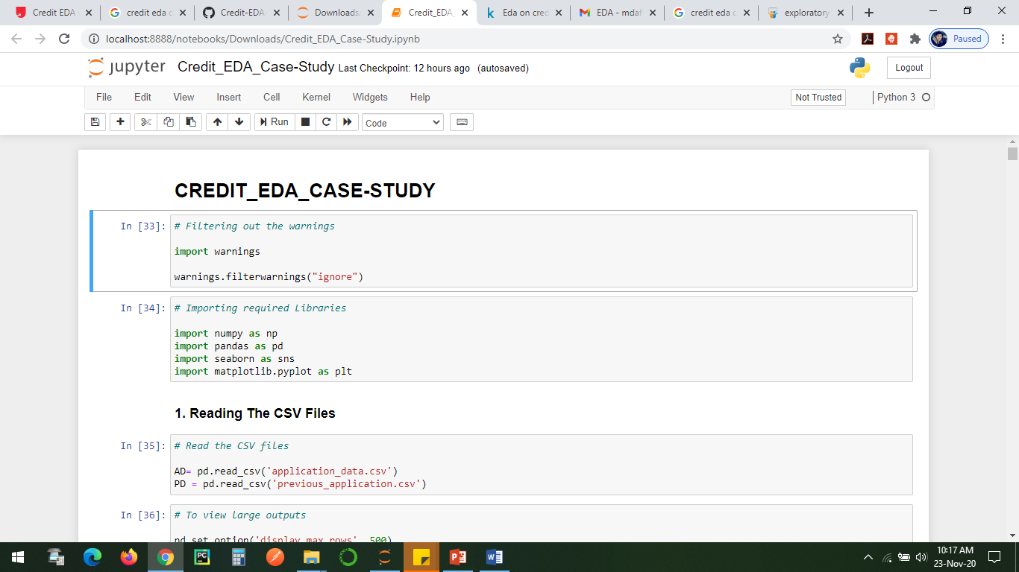
Reading The CSV Files
Before reading the file :
Filtering out the warnings.
Importing required Libraries.
Read the CSV files

Slide 4
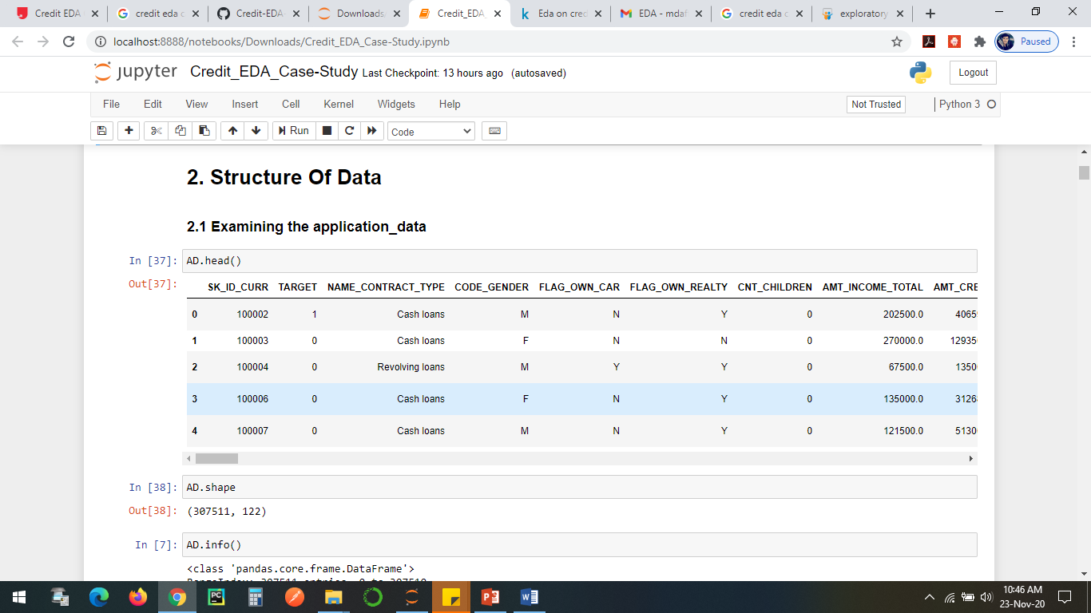
Structure Of Data
Steps to check structure of data:
Shape
Info
Describe

Slide 5
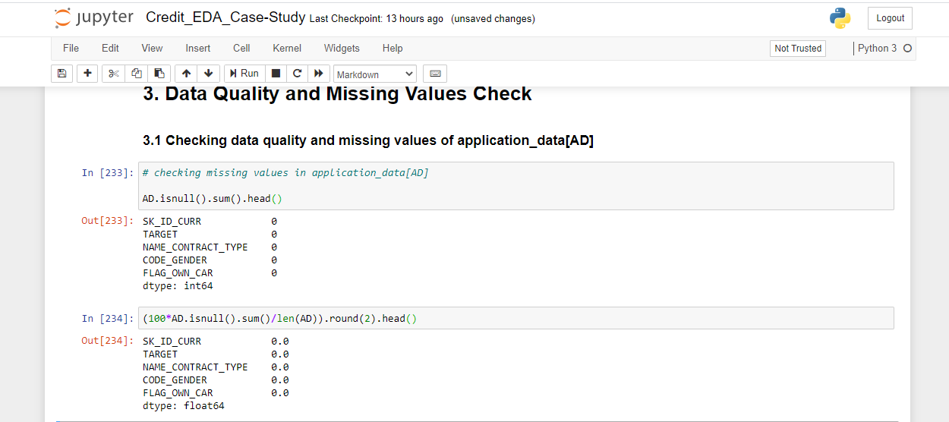
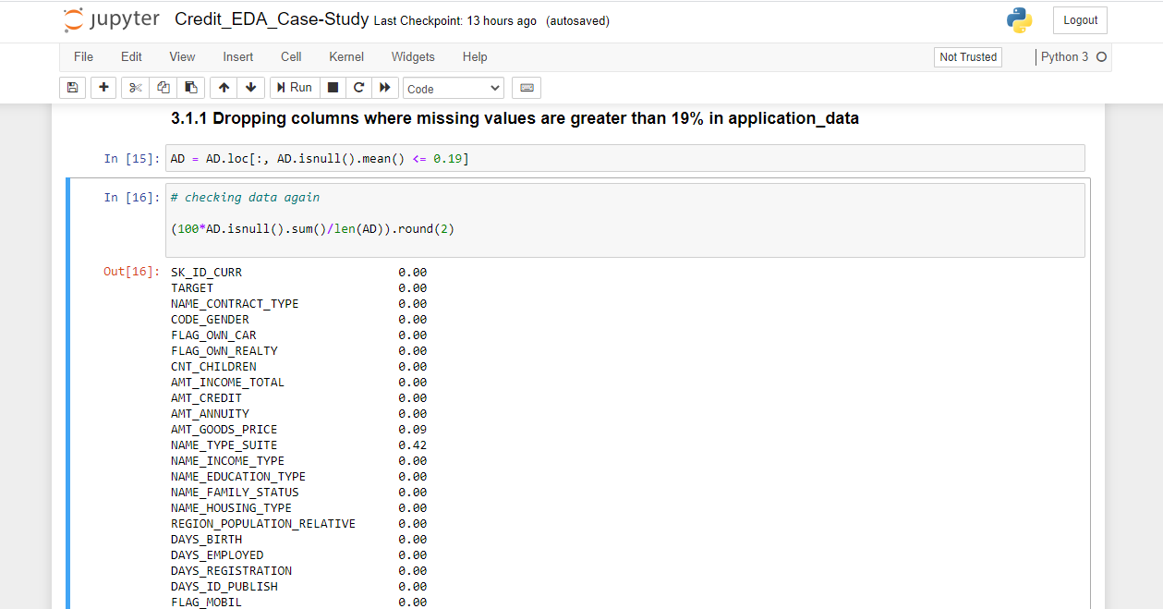
Data Quality and Missing Values Check
Checking data quality and missing values of application_data[AD]
Dropping columns where missing values are greater than 19% in application_data

Slide 6
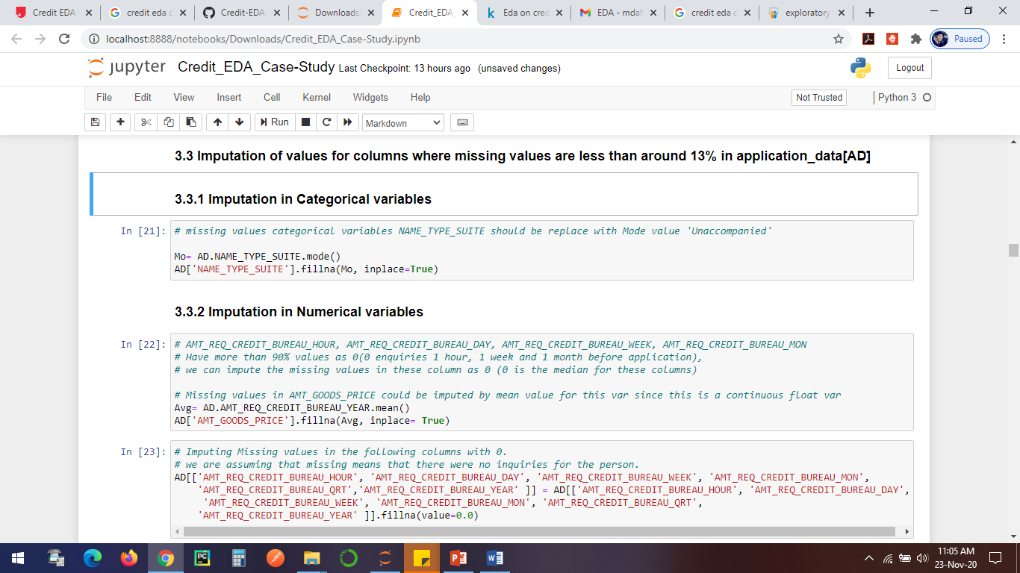
Imputation of values for columns where missing values are less than around 13% in application_data[AD]
Imputation in Categorical variables:-
Missing values in categorical variables NAME_TYPE_SUITE should be replace with Mode value 'Unaccompanied'
Imputation in Numerical variables:-
Missing values in AMT_GOODS_PRICE could be imputed by mean value for this var since this is a continuous float variables.

Slide 7
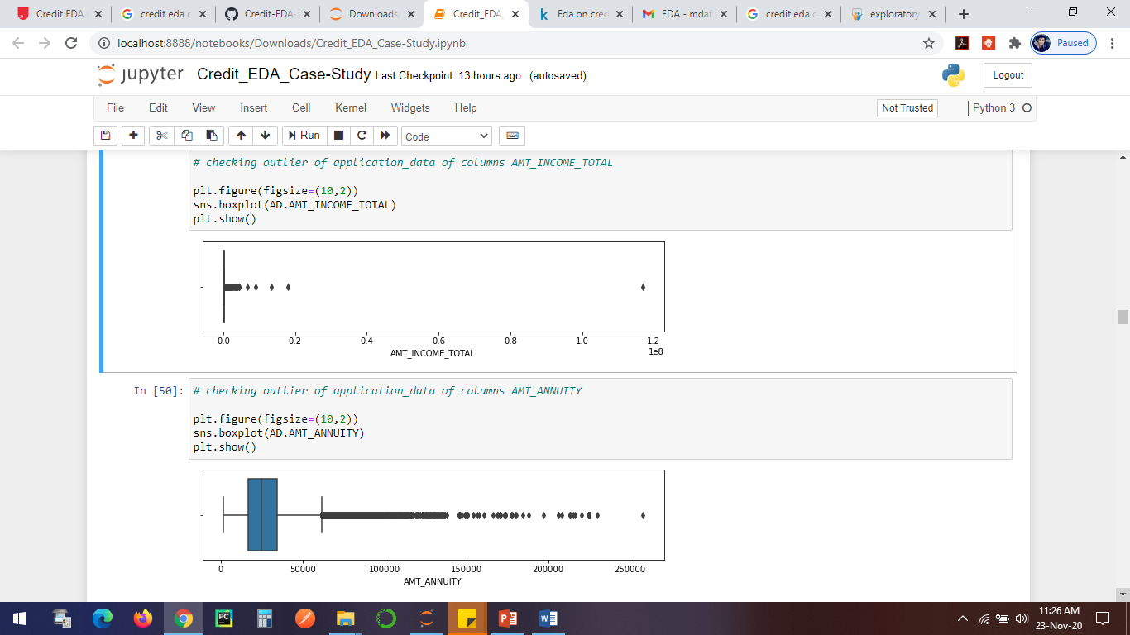
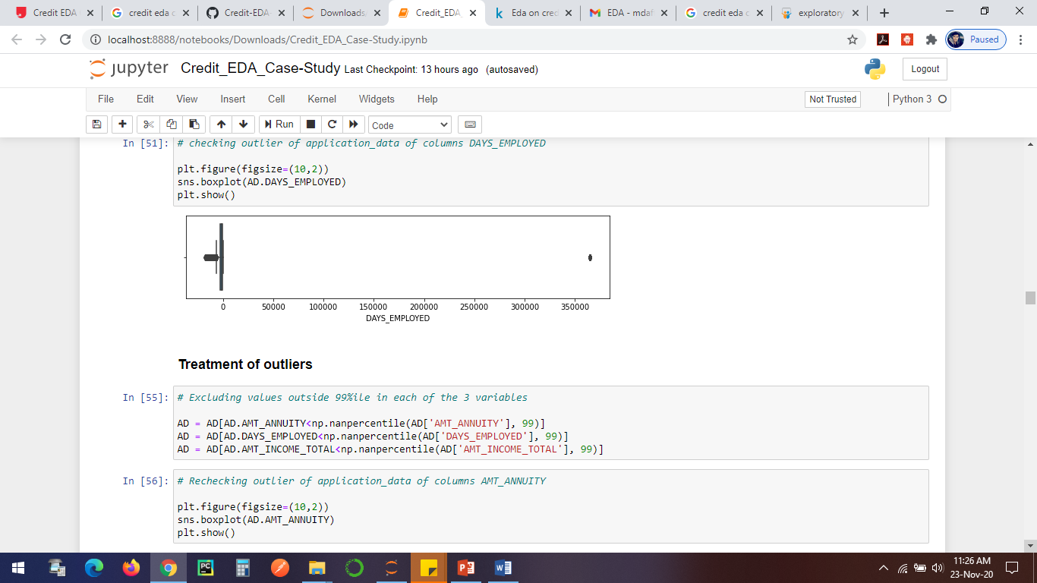
Checking for outliers and treating at least 3 variables in application_data[AD]
Checking for outliers for at least 3 variables
DAYS_EMPLOYED
AMT_INCOME_TOTAL
AMT_ANNUITY

Slide 8
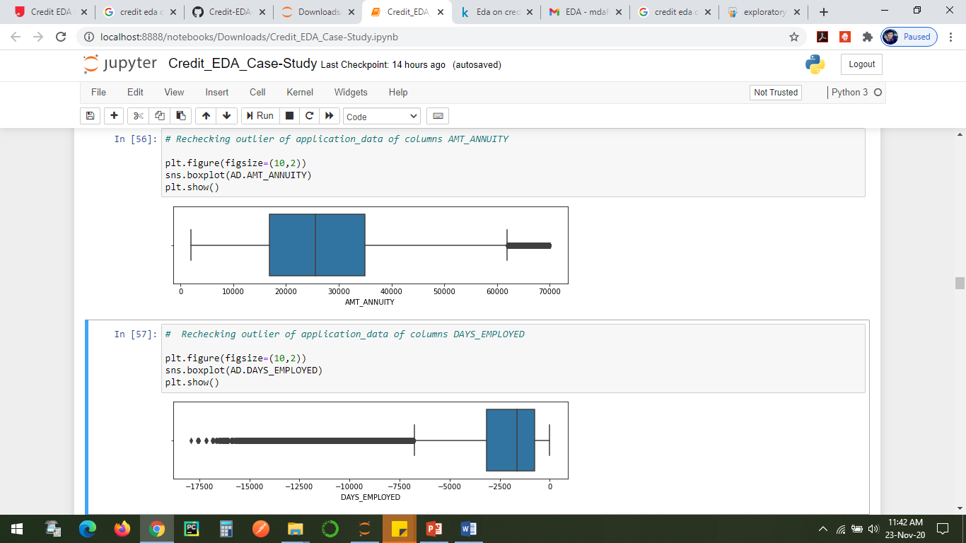
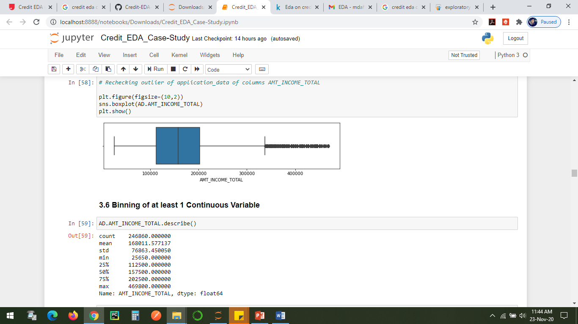
Checking for outliers and treating at least 3 variables in application_data[AD]
After Treating outliers for at least 3 variables
AMT_ANNUITY
DAYS_EMPLOYED
AMT_INCOME_TOTAL

Slide 9
Correlation For target 0
Points to be concluded from the graph presented before.
Points to be concluded from the graph presented before.
Credit sum is conversely relative to the date of birth, which means Credit sum is higher for low age and the other way around.
Credit sum is contrarily corresponding to the quantity of youngsters customer have, implies Credit sum is higher for less kids check customer have and the other way around.
Pay sum is contrarily relative to the quantity of kids customer have, implies more pay for less youngsters customer have and the other way around.
less youngsters customer have in thickly populated zone.
Credit sum is higher to thickly populated zone.

Slide 10
Correlation for type 1
This heat map for Target 1 is also having quite a same observation just like Target 0. But for few points are different. They are listed below.
The client's permanent address does not match contact address are having less children and vice-versa
The client's permanent address does not match work address are having less children and vice-versa

Slide 11
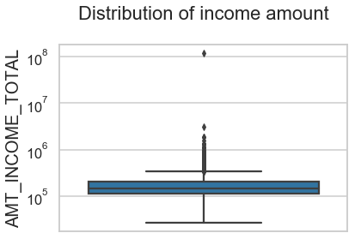
Boxplot for income amount
Few points can be concluded from the graph.
Some outliers are noticed in income amount.
The third quartiles is very slim for income amount.

Slide 12
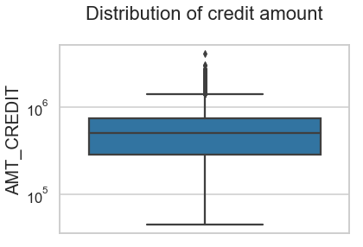
Boxplot for credit amount
Few points can be concluded from the graph.
Some outliers are noticed in credit amount.
The first quartile is bigger than third quartile for credit amount which means most of the credits of clients are present in the first quartile.

Slide 13
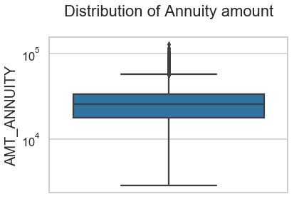
Boxplot for annuity amount
Few points can be concluded from the graph.
Some outliers are noticed in annuity amount.
The first quartile is bigger than third quartile for annuity amount which means most of the annuity clients are from first quartile.

Slide 14
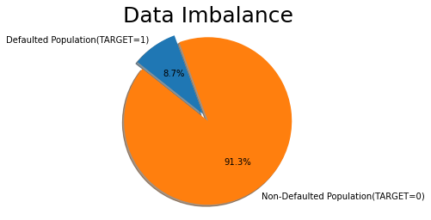
Imbalance with respect to TARGET 0 & 1
we can see that the application_data has high imbalance with Defaulted population at 8.7%
Non-defaulted population at 91.3%. Imbalance ratio is 11.4.

Slide 15
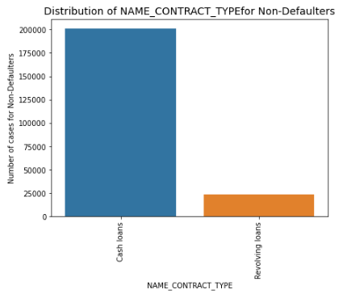
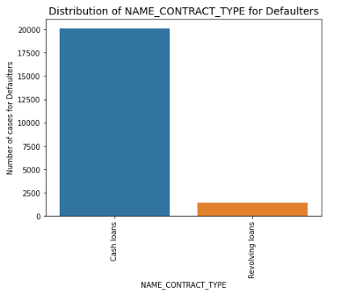
1. we can notice that revolving loans are lesser in the defaulted population. Hence we can infer that revolving loans have comparatively safer. 2. This may be attributed to the Nature of revolving loan as it is considered a flexible financing tool due to its repayment and re-borrowing flexibility.
Unordered Categorical Variables:-
NAME_CONTRACT_TYPE

Slide 16
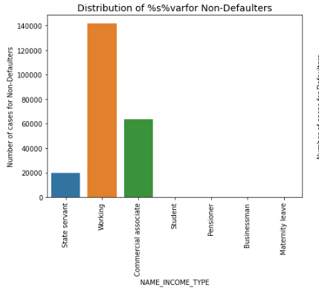
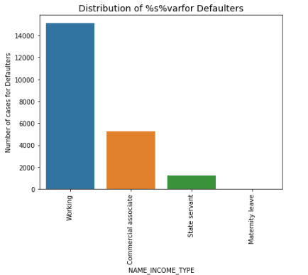
NAME_INCOME_TYPE
Unordered Categorical Variables:-
Most of the Defaults are from working population

Slide 17
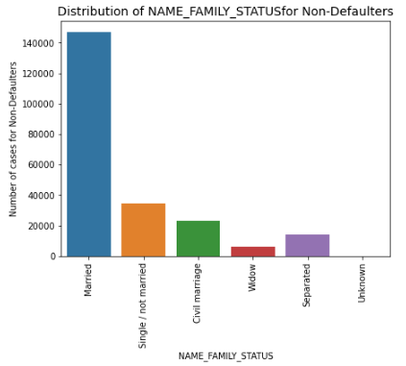
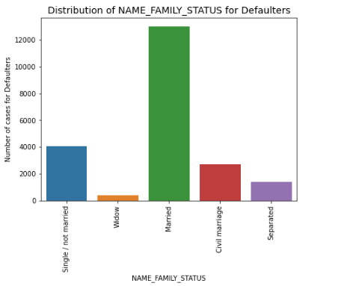
NAME_FAMILY_STATUS
Unordered Categorical Variables:-
1. Single/ not married is proportionally higher in defaulted population as compared to non defaulted population.
2. This shows that single applications have higher defaults.

Slide 18
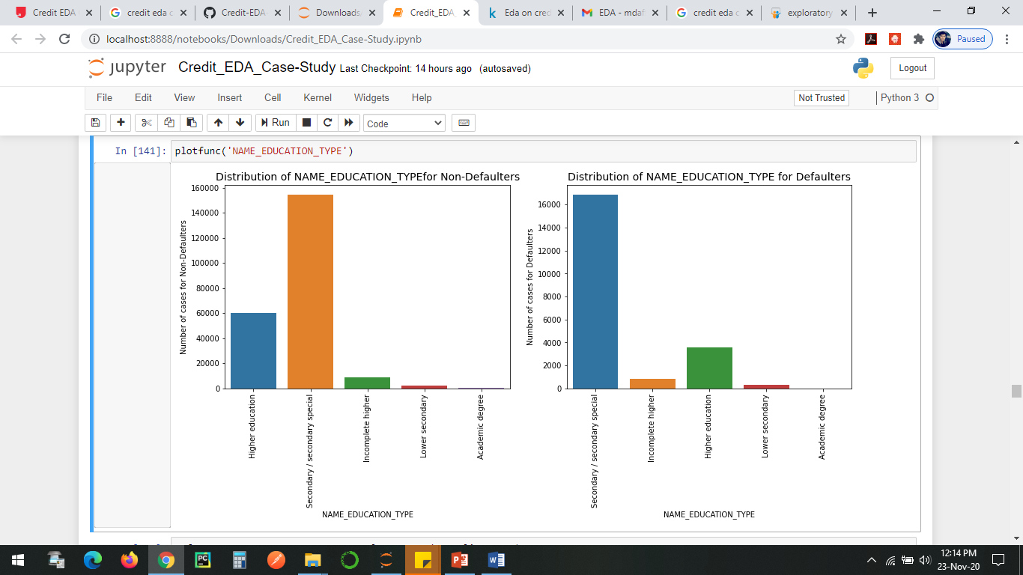
Ordered Categorical Variables:-
NAME_EDUCATION_TYPE
1. Higher education count is proportionally lesser in defaulted population as compared to Non Defaulted population.
2. Hence Higher the education level, lower the default rate.
3. This is logical as logical as higher degree category should be earning more and hence easier to pay off loan installments.

Slide 19
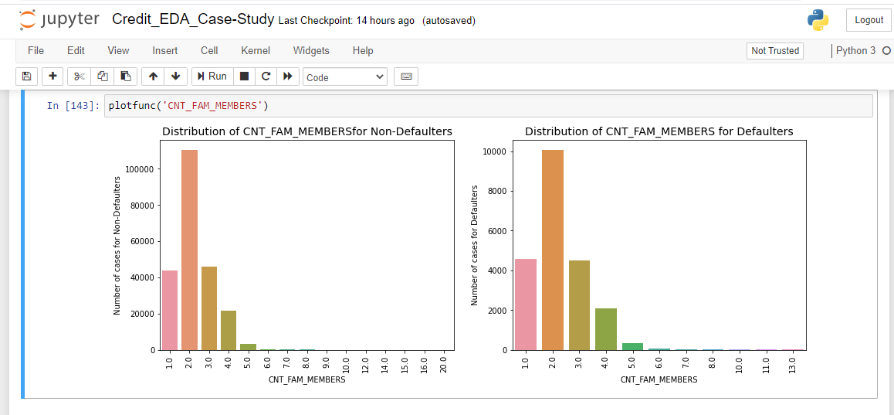
Ordered Categorical Variables:-
CNT_FAM_MEMBERS
1. Children count seem to have some impact on default rate.
2. As the proportion for higher count of children is more in defaulted population as compared to non defaulted

Slide 20
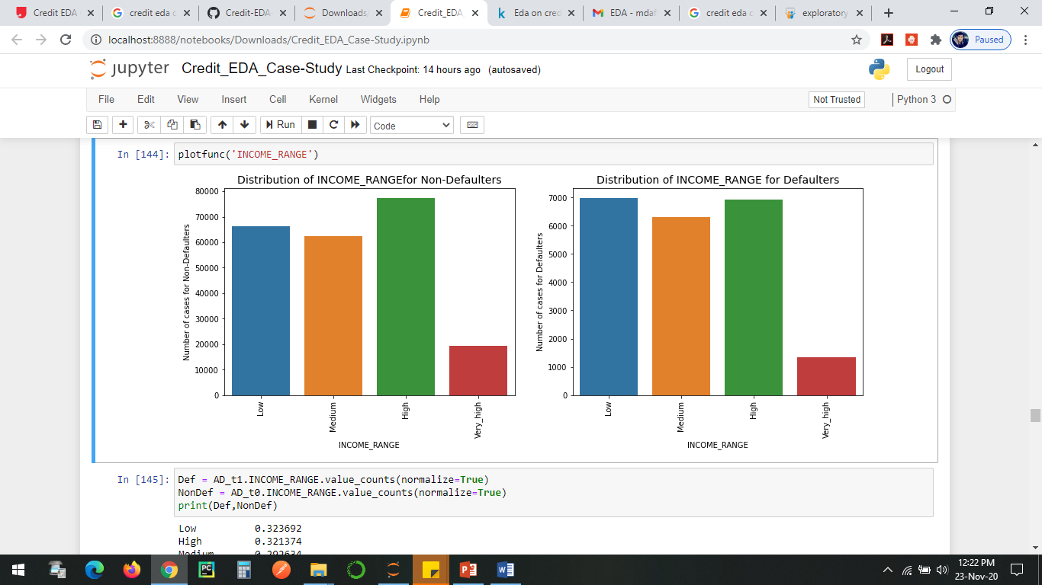
Ordered Categorical Variables:-
INCOME_RANGE
Low income range has higher defaults as their proportion in defaulted population is higher than in the non defaulted population

Slide 21
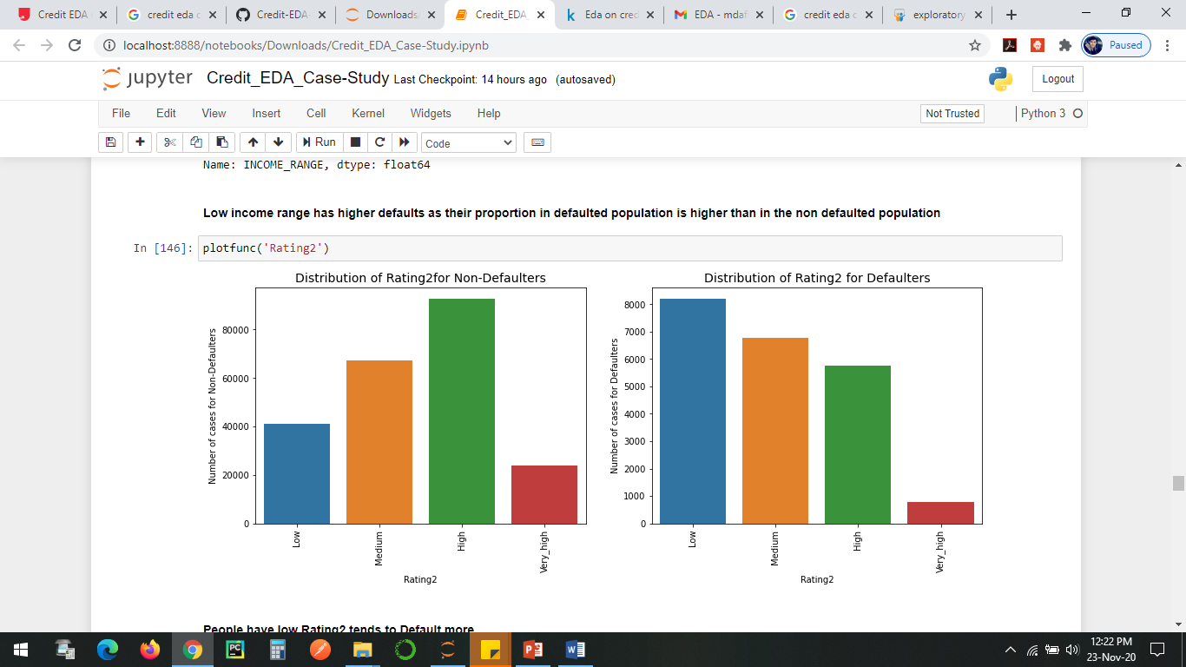
Ordered Categorical Variables:-
Rating2
People have low Rating2 tends to Default more

Slide 22
Correlation For target 0
Credit amount is inversely proportional to the date of birth, which means Credit amount is higher for low age and vice-versa.
Credit amount is inversely proportional to the number of children client have, means Credit amount is higher for less children count client have and vice-versa.
Income amount is inversely proportional to the number of children client have, means more income for less children client have and vice-versa.
less children client have in densely populated area.
Credit amount is higher to densely populated area.
The income is also higher in densely populated area.

Slide 23
Correlation for type 1
This heat map for Target 1 is also having quite a same observation just like Target 0. But for few points are different. They are listed below.
The client's permanent address does not match contact address are having less children and vice-versa
The client's permanent address does not match work address are having less children and vice-versa

Slide 24
conclusion
Banks should zero in additional on contract type 'Student' ,'retired person' and 'Businessman' with housing 'type other than 'Community loft' for fruitful payments.
Banks should zero in less on pay type 'Functioning' as they are having generally number of ineffective payments.
Likewise with credit reason 'Fix' is having higher number of ineffective payments on schedule.
Get as much as customers from housing type 'With guardians' as they are having least number of ineffective payments.

Slide 25
Thank you

